Slide 1
Photometry
ASTR 257

Slide 2
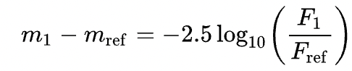
The Magnitude System
Telescopes (especially ground-based telescopes) are better at measuring relative fluxes than absolute fluxes because there are always unknown transmission effects (for example, from the sky)
For better the worse, the equation is in log space in factors of 2.5. So we’re translating, “Star A is 10 times brighter than the reference star” to “Star A is 2.5 magnitudes brighter [lower number] than the reference star.”
Flux can be any units. Watts/m^2. Ergs/cm^2/s/nm, Janskies (for radio and infrared astronomy), or detector counts.
Can use the same equation to convert a magnitude to a flux by making Vega (mag: 0) which has known fluxes.

Slide 3
Measure Brightness with Aperture Photometry
BASIC IDEA
Measure counts in a circular aperture
Subtract sky background based on average counts in a circular annulus (doughnut)
Put a buffer between the aperture and the background annulus because there’s still some star flux in the buffer region.
CALIBRATION
If a cloud passes overhead, or the atmosphere changes in transparency, all stars in your field will dim by approximately the same amount.
Always measure counts in a relative sense (did my science target get fainter compared to other stars in the field).
Try different aperture/annulus sizes to determine if your answer is robust.

Slide 4
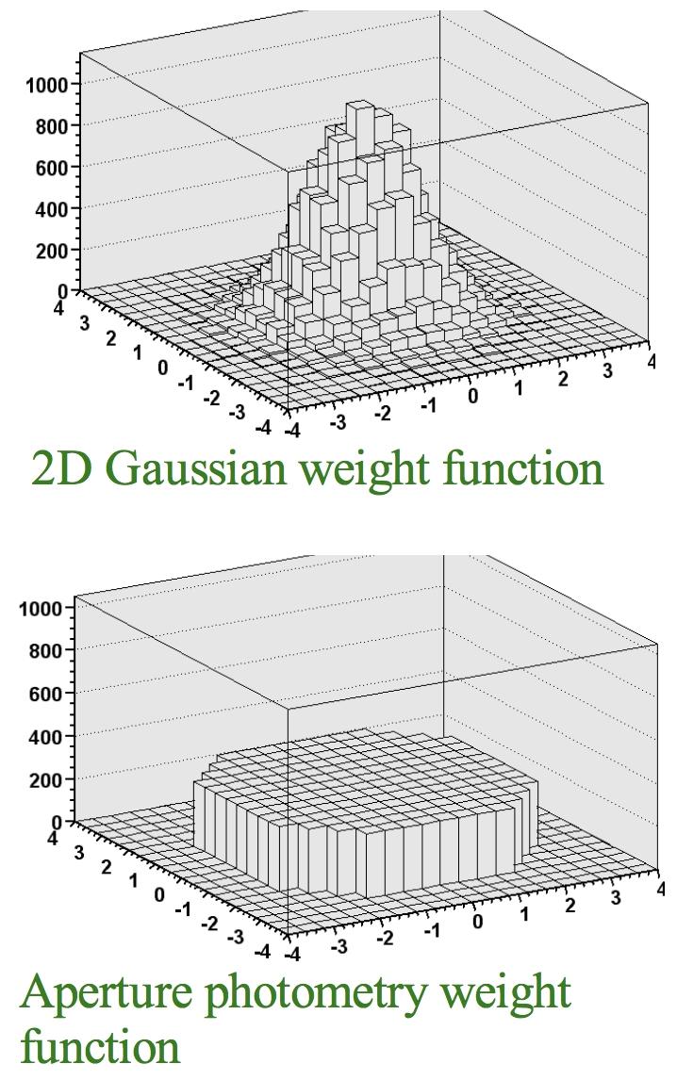
PSF Fitting Photometry
More photons near the center of the star image, so you get better photometric precision (or higher signal-to-noise) by up-weighting the central pixels.
Really the only thing you can do for crowded field photometry.
A little harder to program, and you better know the shape of your point-spread function (PSF) well, otherwise aperture photometry is safer.

Slide 5
Crowded-Field Photometry
Aperture photometry definitely won’t work.
There are fancy algorithms for doing this. A simple one would be to average together some bright stars to make a PSF and then PSF-fit every star in the field, starting with the brightest ones.
We will use pre-packaged code to do this tonight.

Slide 6
Filters
Near
Beware, you almost never know your filter perfectly. Lots of astronomers use “R” filters that are slightly different, and your optics, detector, and site also contribute to differences.

Slide 7
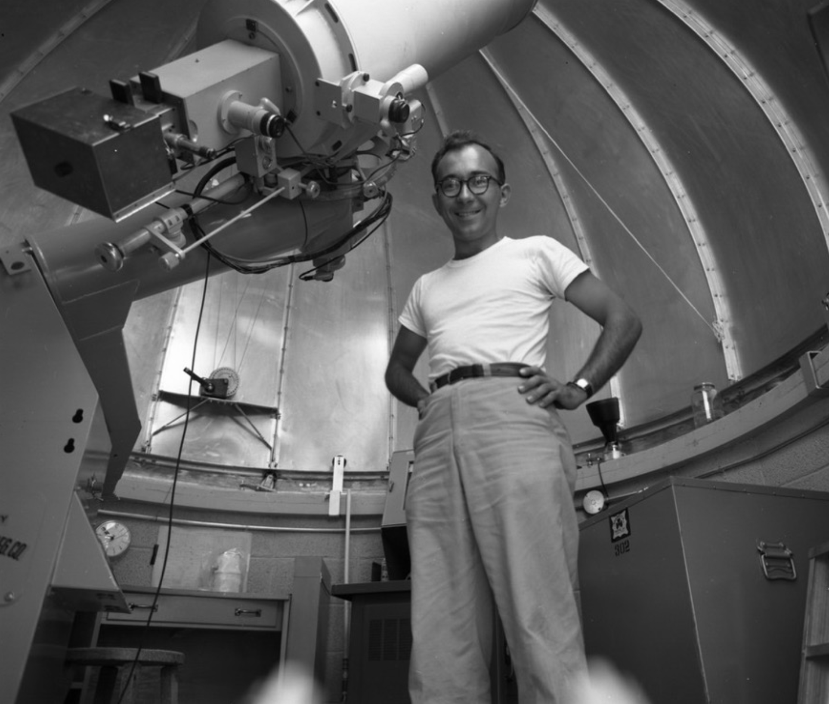
Absolute Calibration—Converting Raw Counts into Energy Flux
Observe your field, then observe a Landolt Field. Compare the number of counts in your star with the number of counts in a Landolt star.
Landolt Fields are equatorial (visible from all telescopes), span all RAs, and have isolated non-variable stars with magnitudes measured by Arlo Landolt.
0-magnitude is usually defined to be Vega, but be careful about this.
Still need to convert 0-magnitude into flux. White dwarfs are good for this because we understand them pretty well. There have been direct measurements of calibration sources too. If you look into this too carefully, you will start to get very worried about astronomical photometry.
Arlo Landolt, Astronomy Hero

Slide 8
Another Way: All-Sky Surveys
LSST
GAIA
SDSS (with Connie Rockosi, Astronomy Hero)

Slide 9
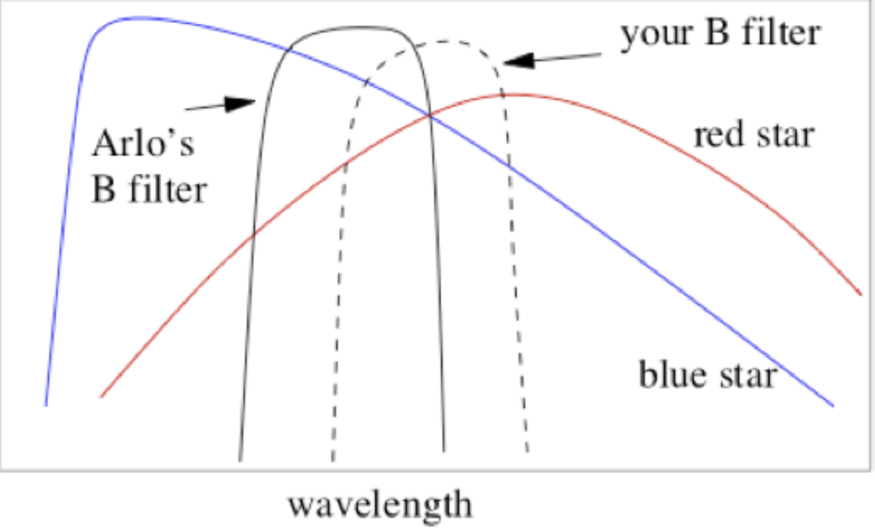
This is almost impossible to do perfectly

Slide 10
Can be partially compensated by photometric transforms.
B = C₁*B_{measured}+C₂*(B_{measured}-V_{measured})+C₃*airmass *B_{measured}
…and can add higher-order terms
Fit the constants by observing multiple Landolt Fields.
Conditions need to not change between observing your field and several Landolt Fields
“Photometric Conditions” means you can’t see any clouds anywhere in the sky.

Slide 11
Making an HR Diagram

Slide 12
Making an HR Diagram
Follow same planning procedure you did for Pluto, but now do two filters (B and V)
Plan daytime calibrations
Plan Landolt calibration
Initial data processing is the same, but then you’ll have to do photometry with photutils
Photometry data reduction is tricky, so we have all day tomorrow to do this

